Slide 1





Group 5
invoice generation App
A Application made for invoice generation for super-markets or departmental store

Slide 2
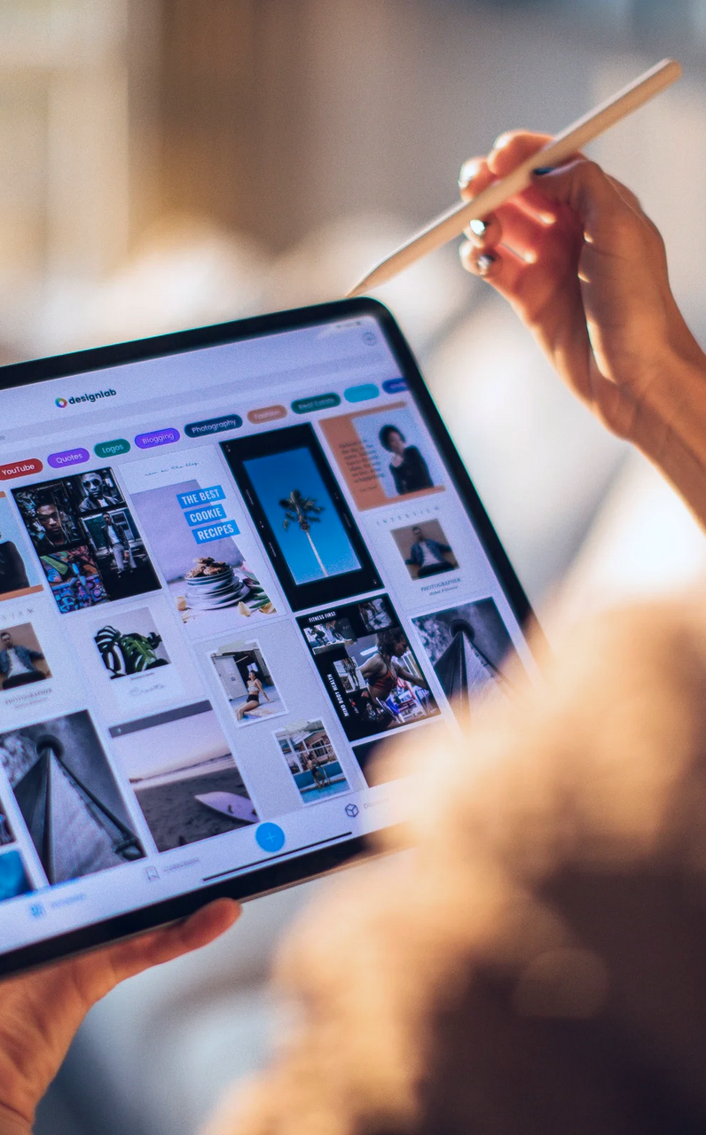

Presentation Agenda
01.
Meet the team
05.
The product
Slide 2
Slide 7
02.
Introduction
06.
Demo
Slide 3
Slide 11
03.
how it works
07.
Contacts
Slide 5
Slide 13
Page 01

Slide 3
Meet
Our
Team
Krystina Thokchom
Longjam Debika
Lois Tourangbam
BC-2224
BC-2238
BC-2203
we are a small group of students from 2nd Semester doing BCA
Invoice generator
Satees thokchom
Naoroibam borish singh
BC-2202
Page 02
BC-2220

Slide 4

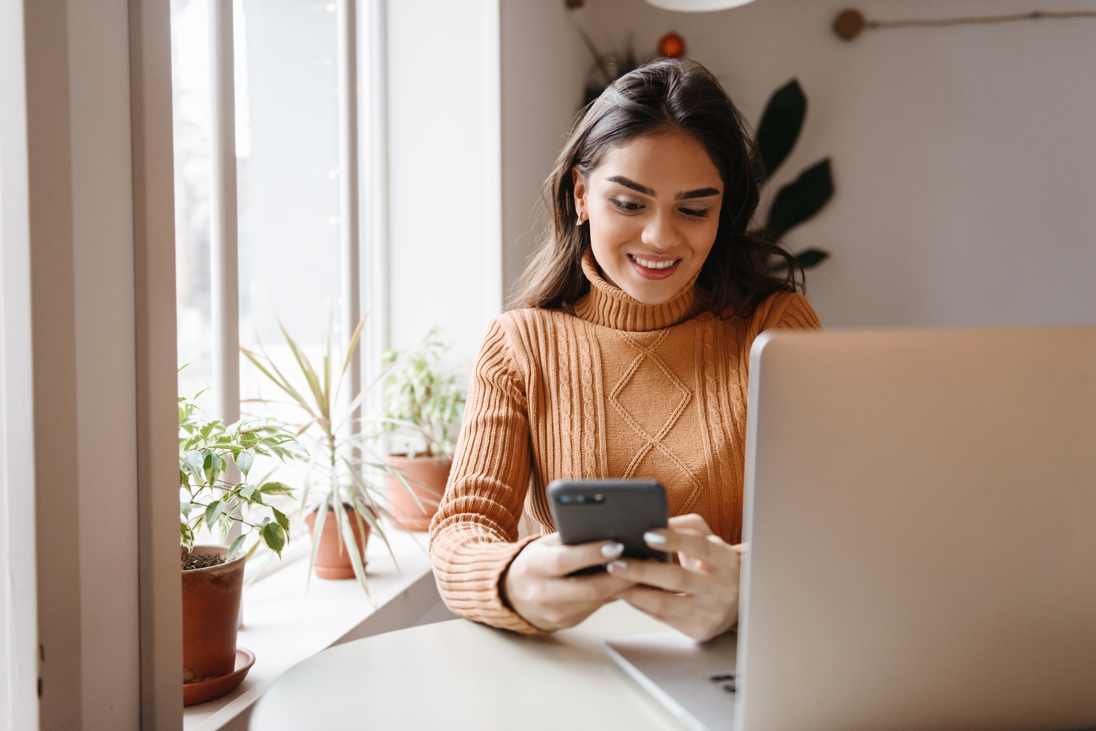

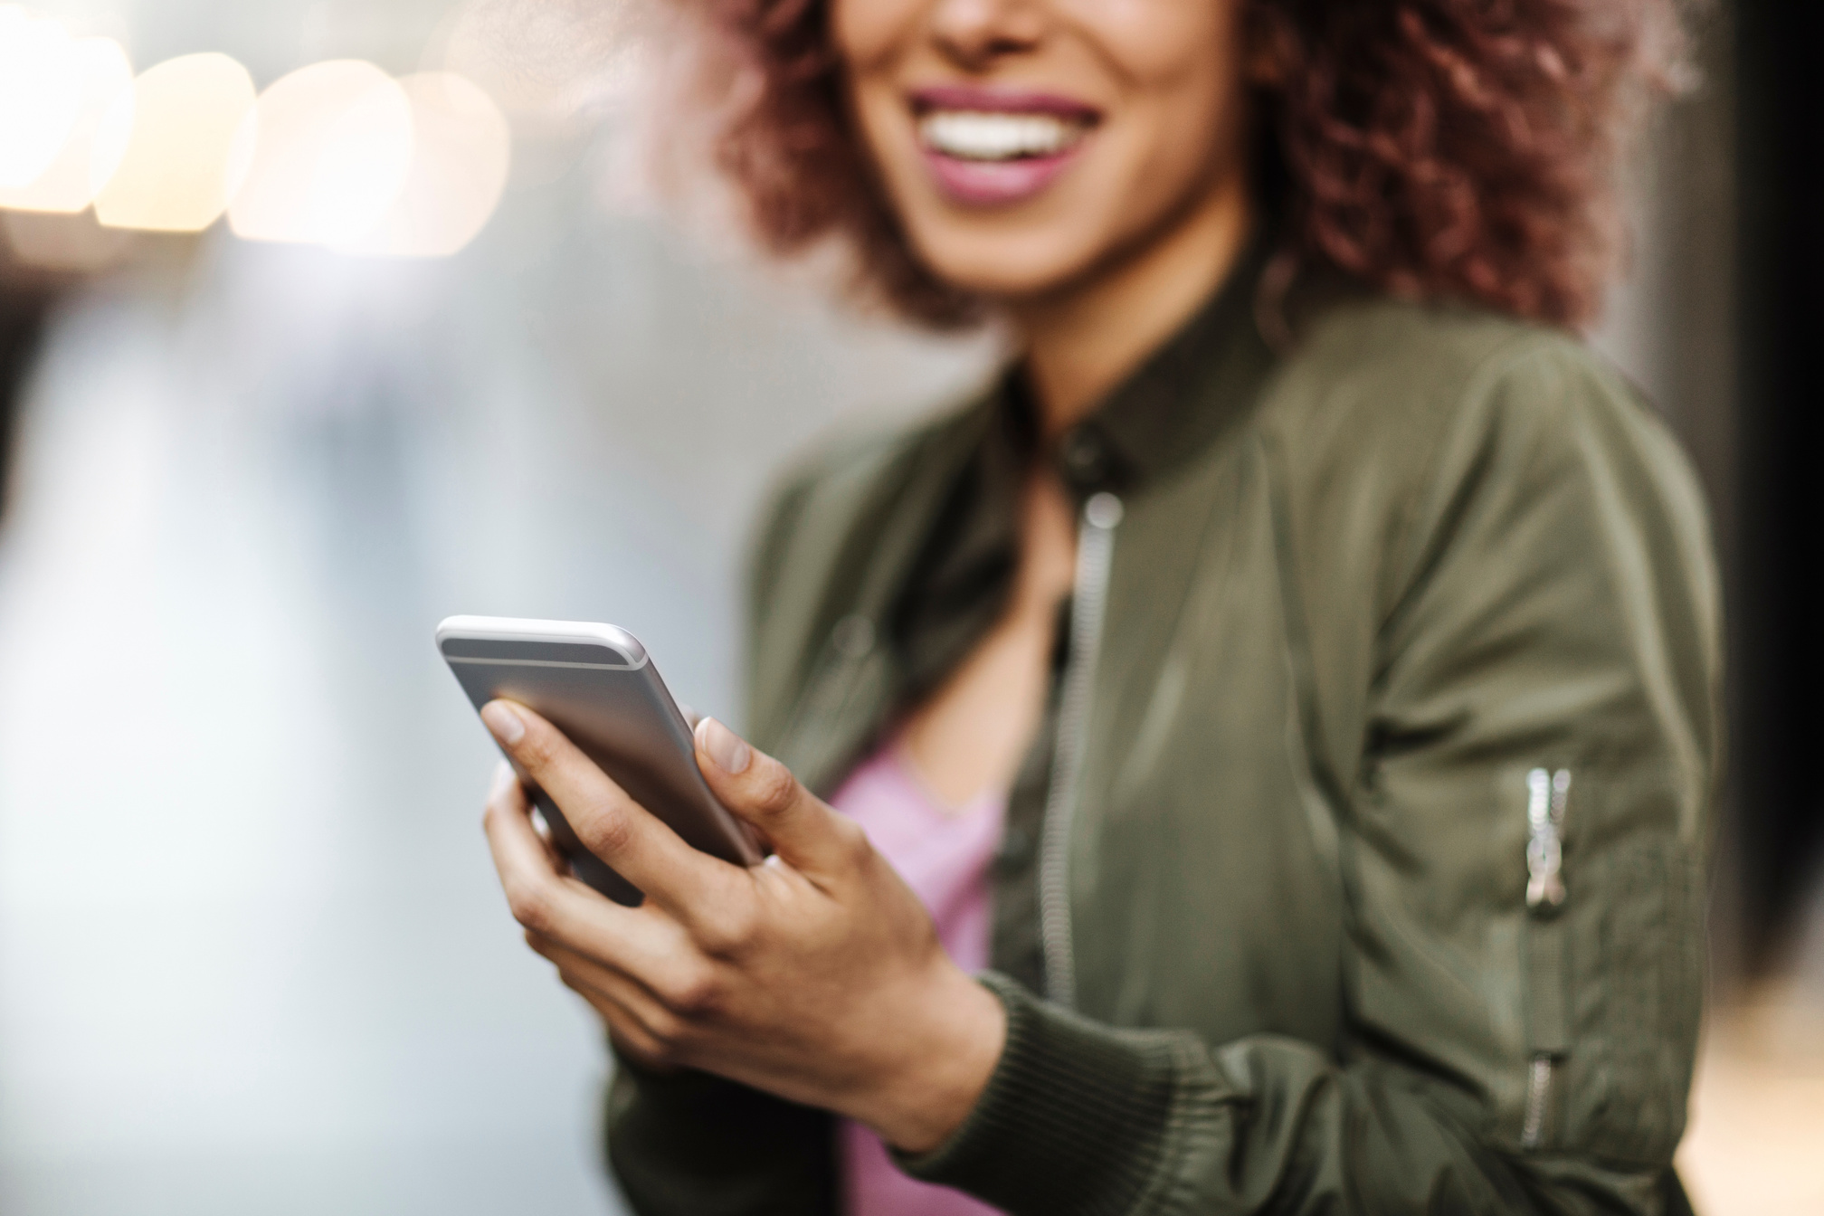
About the code:
The Invoice Generator Application is a simple desktop application built using Python's Tkinter library for the graphical user interface (GUI) and ReportLab for generating PDF invoices. The application allows users to input customer information, add items with quantities and prices, and generate a formatted invoice in PDF format.
Page 03

Slide 5



Introduction
Introduction
how it works
Benefits
It is a application made for generating invoices for the the customer
The Application takes in the information of the customer the product details and gives out the invoice letter after tax and calculation.
The application is biased for the super-markets and for big places that require to keep big inventories
Page 04

Slide 6





How it works:
Download
in the first step the application takes the data and all the information needed to generate and invoice from the user
Registration
Next comes in the registration of the data and put it in the correct places
The execution
After the whole registration of the information in the program the execution takes place
Results
After the execution the program gives out the result of the program to the user
Page 05

Slide 7
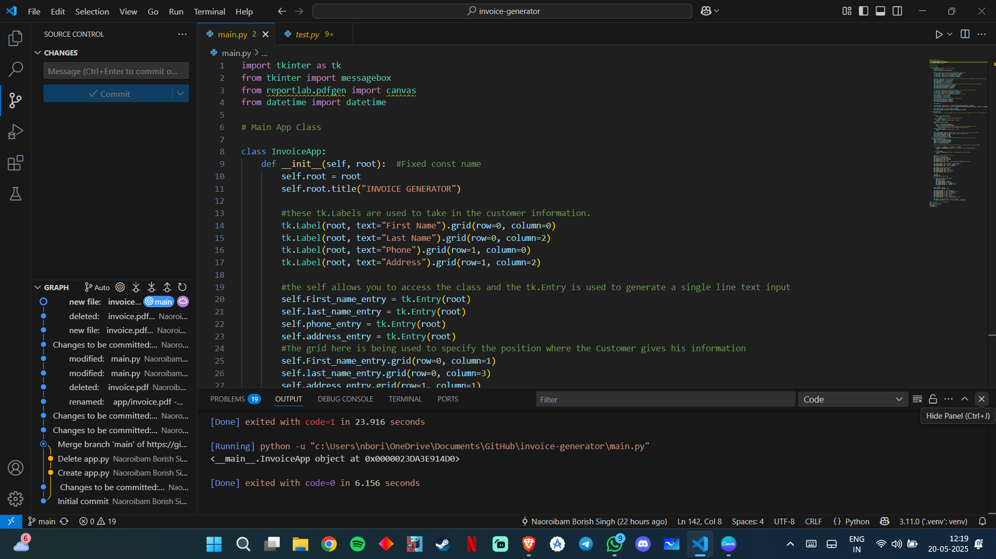
SOURCE CODE:
Page 06

Slide 8
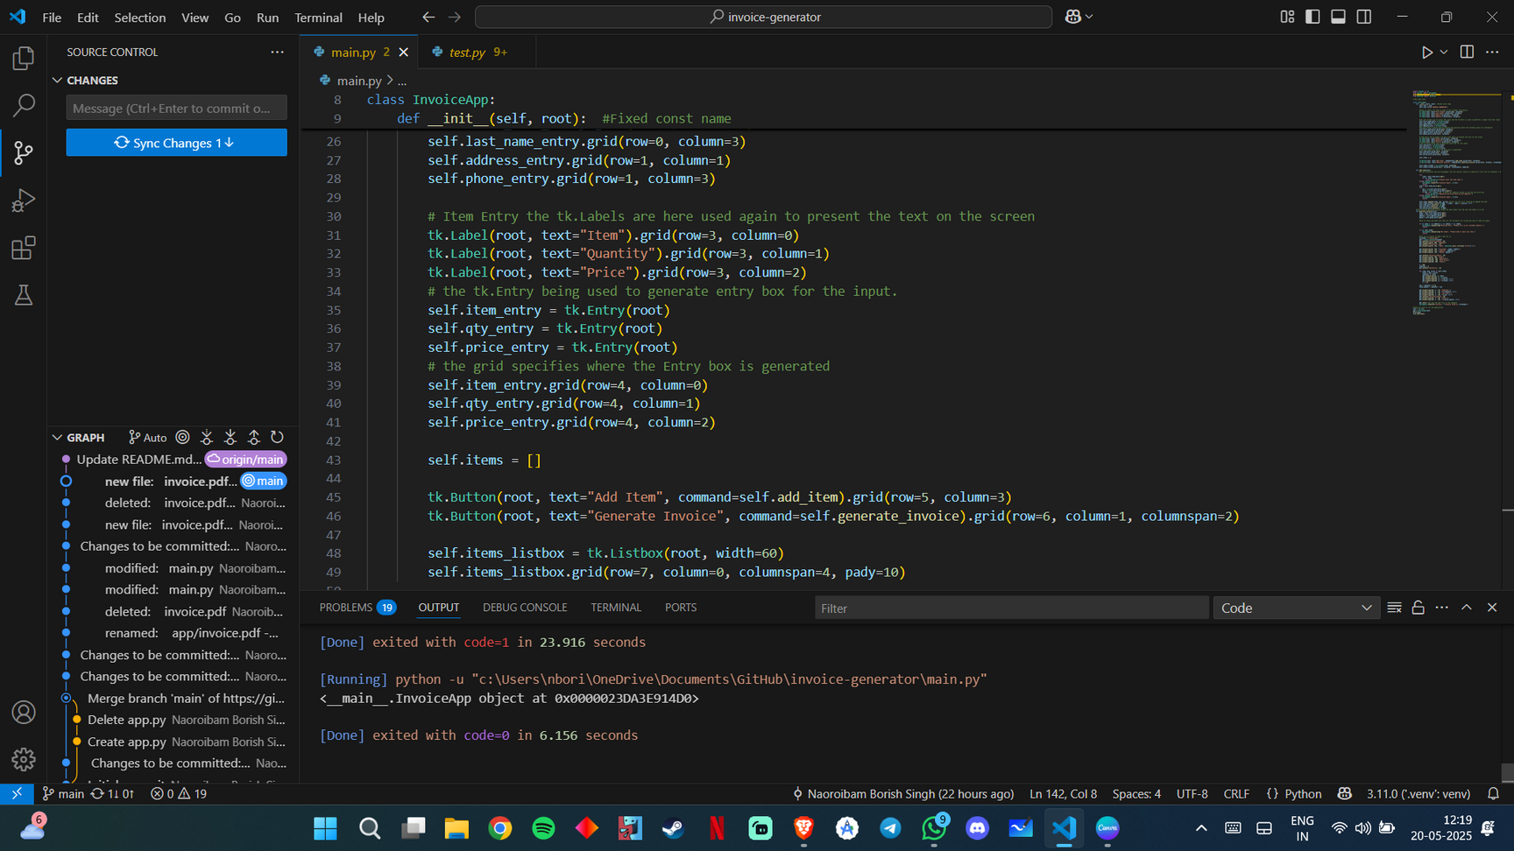
SOURCE CODE:
Page 07

Slide 9
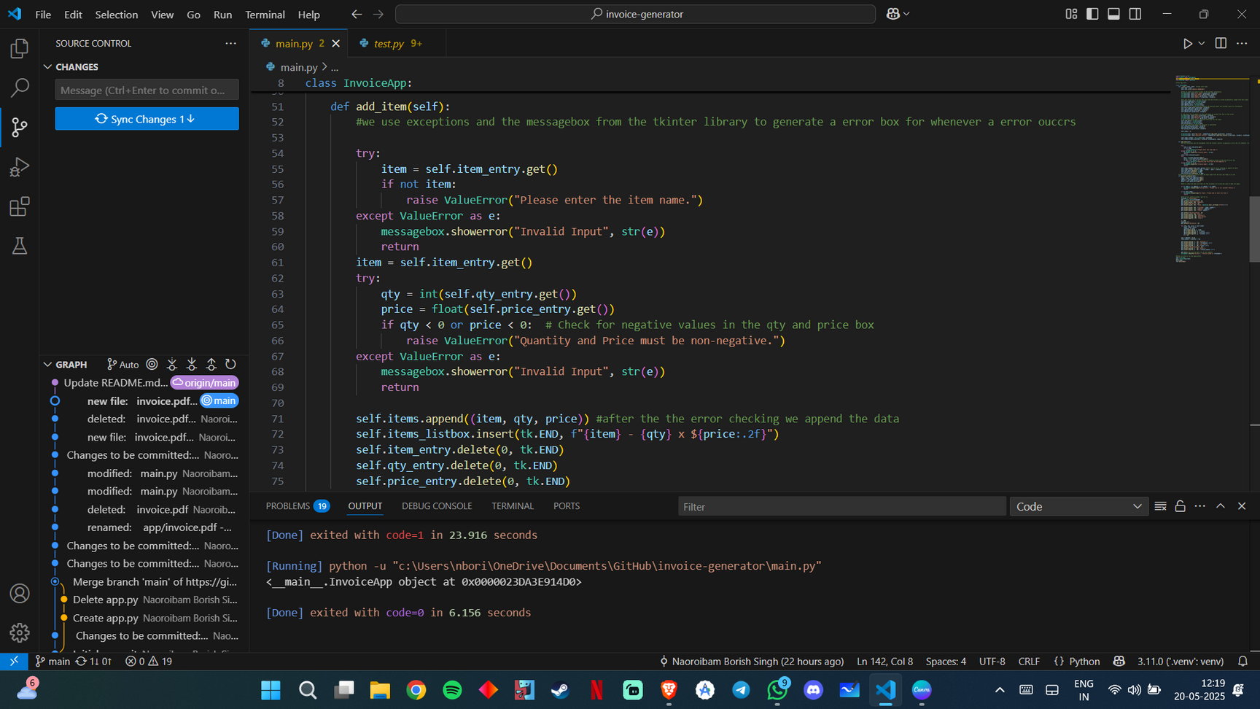
SOURCE CODE:
Page 08

Slide 10
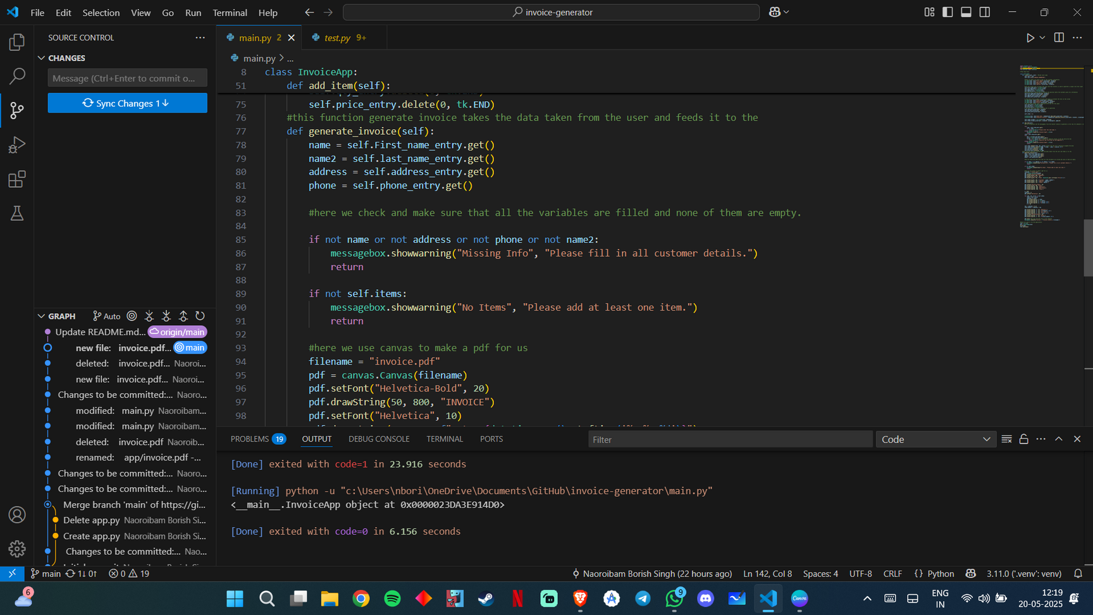
SOURCE CODE:
Page 09

Slide 11
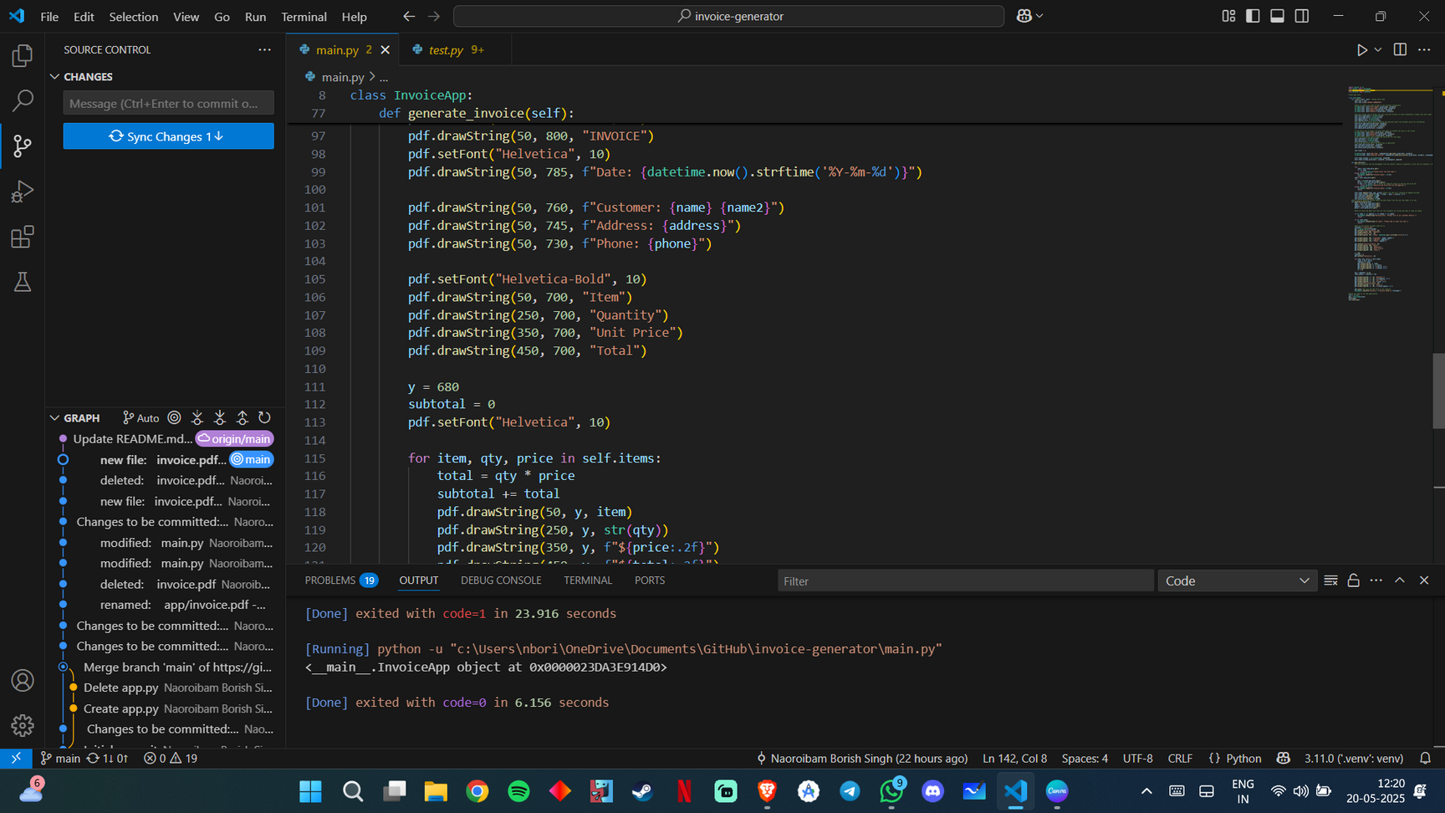
SOURCE CODE:
Page 08

Slide 12
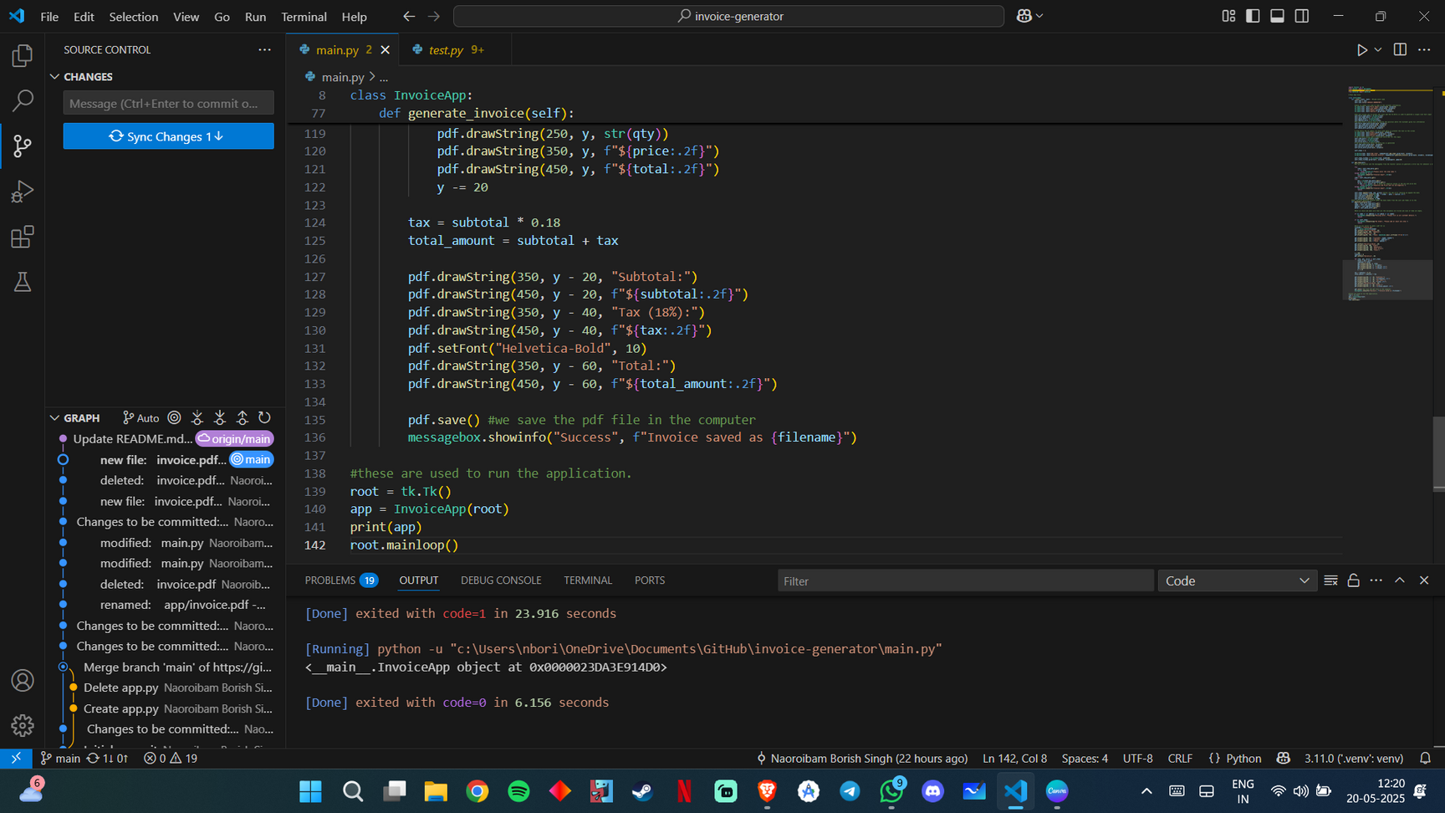
SOURCE CODE:
Page 09

Slide 13
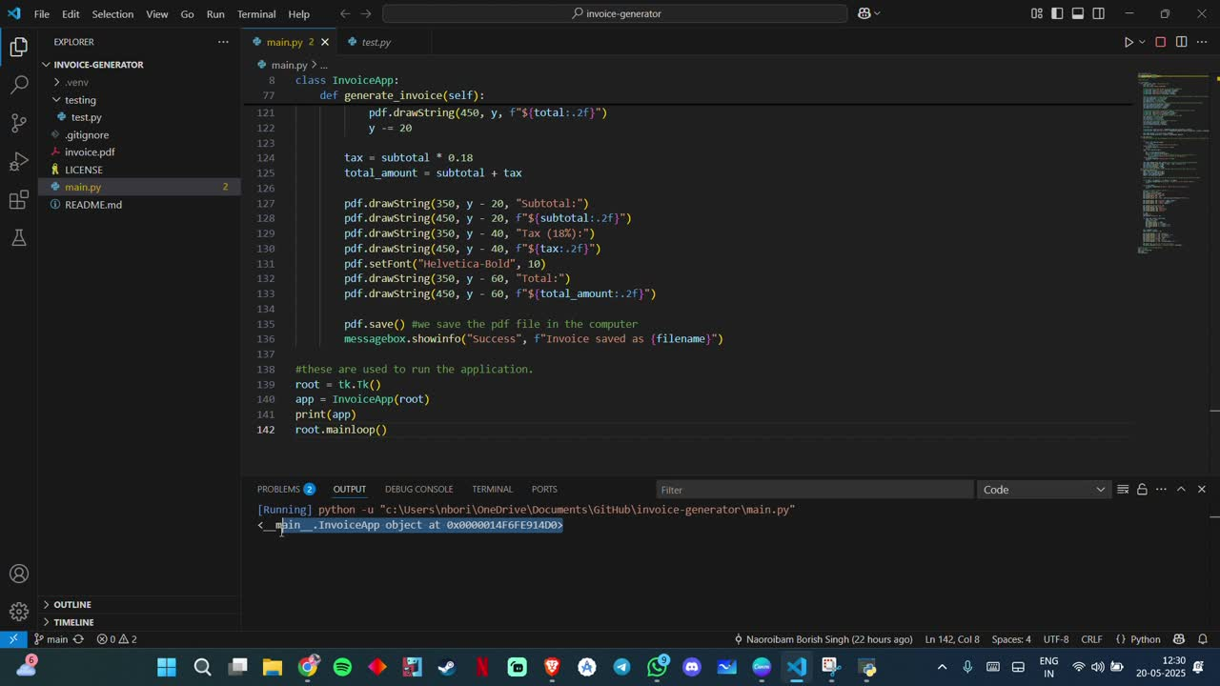
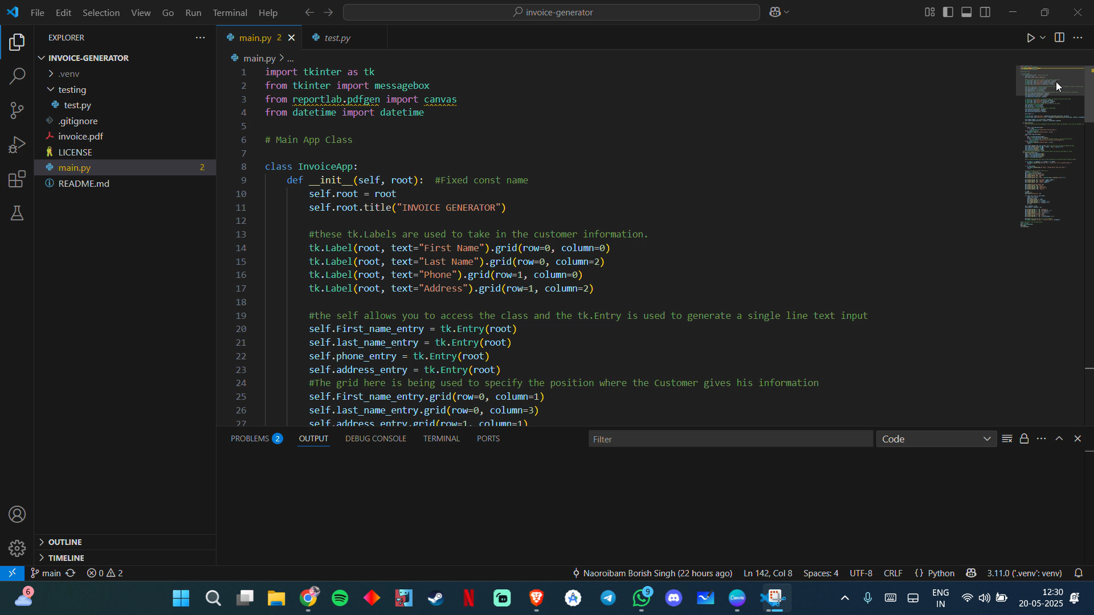
A Demo to the APP
This Demo shows us how the Application works and how it functions
THE APP DEMO
Page 10

Slide 14


Email
nborish94@gmail.com
liathokchom29@gmail.com
loist18932@gmail.com
longjamdebika@gmail.com
abcd@gmail.com
Contacts
As a team it wouldn’t have been easy to do it without them.
Page 11

Slide 15
Thanks For
Your Attention

